Slide 1


Processing Near Memory for HPC and AI with HBM : AIA (Accelerate Indirect memory Access)
Shiju Li

Slide 2
The Sparsity Challenge: Unlocking Performance in AI and HPC
The Problem: Data in the Real World is Sparse
HPC Physics Simulations
Sparse Linear Algebra (SpMV, SpMM, SpGEMM, …)
Graph applications (BFS, PageRank, SSSP, ..)
AI (LLMs, GNNs ..)
The Performance Penalty: Why Sparsity Hurts
Irregular Memory Access
The cycle of Inefficiency
Big Cache Miss Ratio
Memory Bandwidth is Wasted
Execution Units Stall

Slide 3
HPC Application

Slide 4
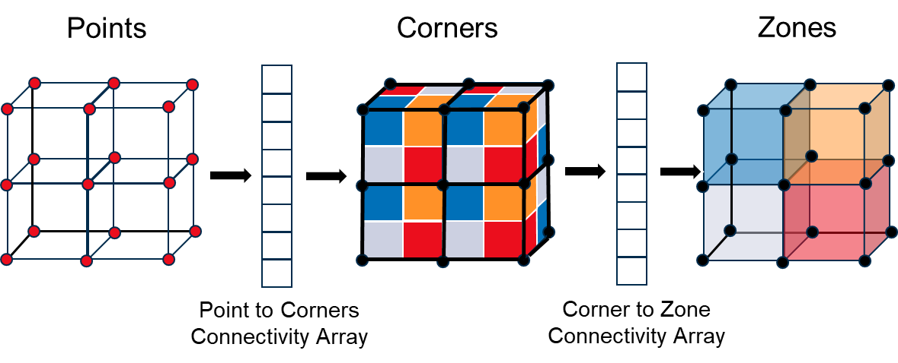
Challenge of Sparsity for HPC application
UME is a C++20 proxy based on a large computational physics application
Approximates memory layout and indexing of an unstructured mesh
Extracts an important computational kernel
7 computation loops with indirect memory accesses (1 or 2 levels of indirections)
Significant (52%) time is spent memory operations due to unstructured mesh operations
Want to move only the data we need for computation
Instruction | Count | Percentage
Load | 6,775,030,849 | 18%
Branching | 6,063,697,707 | 16%
Integer Add | 5,334,155,682 | 14%
Array Indexing | 4,855,537,532 | 13%
Conditional | 3,299,248,274 | 9%
Store | 2,599,966,427 | 7%
Type cast | 1,959,938,043 | 5%
Sign extension | 1,541,094,404 | 4%

Slide 5
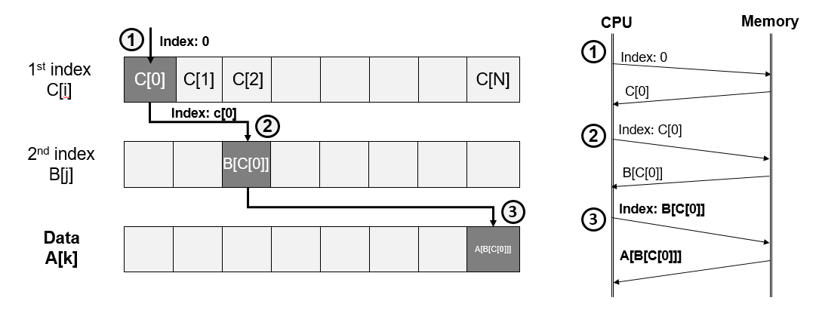
Indirect (Irregular) Memory Access
=2
B[2]=7

Slide 6
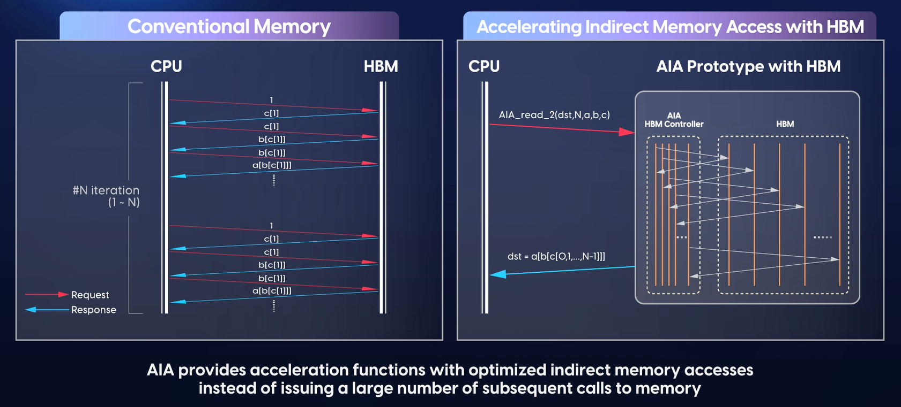
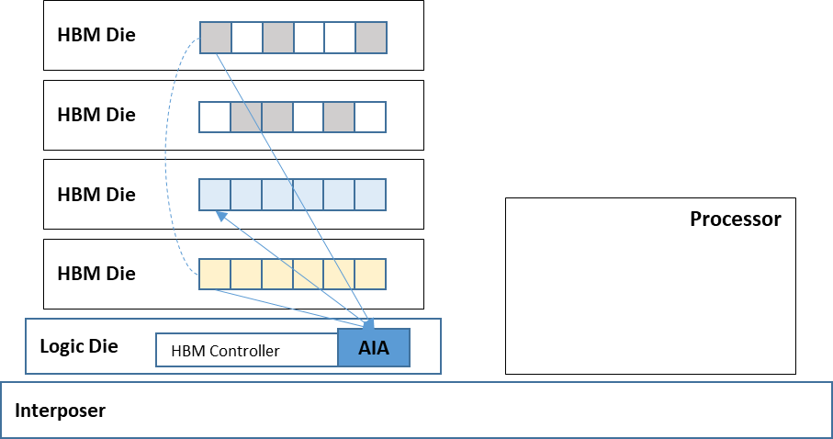
AIA - HBM (with Los Alamos National Lab.)
Irregular memory access in parallel using multiple processing units and DRAM channels efficiently
Only the resulting data is delivered → reduces data movement between processor and memory
BW efficiency

Slide 7
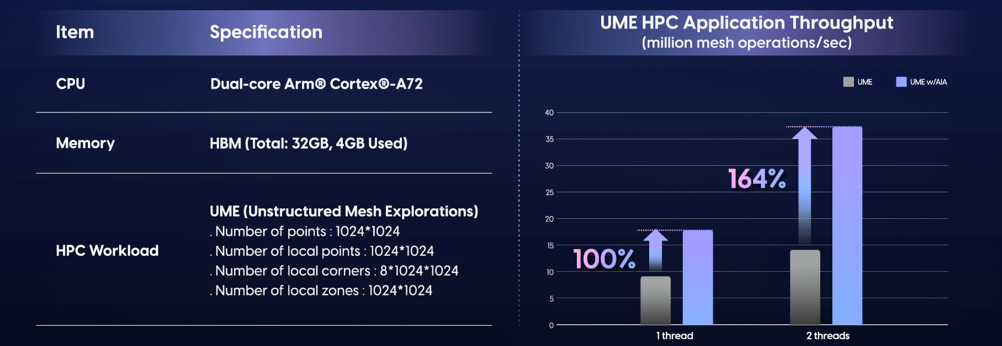
Performance Benefic for UME w/ AIA

Slide 8
Sparse Linear Algebra

Slide 9
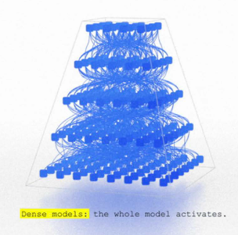
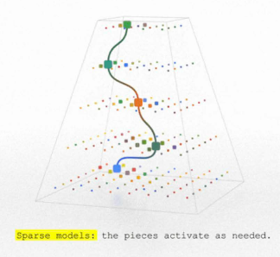
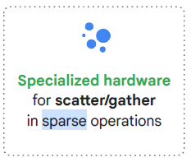
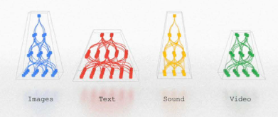
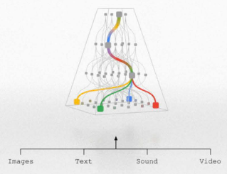
Sparse Matrix Multiplication and AI
Pruning based Sparse Model require to accelerate sparse matrix multiplication performance
Specialized gather functions in sparse operation are needed
Before Pruning
After Pruning
Efficient Sparse Model
Dense Model
Sparse Model
3 | 5 | 6
3 | 4 | 6
2 | 7 | 2
3 | 5 | 6
3 | 4 | 6
2 | 7 | 2
3 | 5 | 6
3 | 4 | 6
2 | 7 | 2
0 | 5 | 0
0 | 0 | 1
2 | 0 | 0
Models that deal with many modalities
Dense
Matrix
Sparse
Matrix
[ Hardware for Deep Learning @ HotChips 2023,
Presenter : Bill Dally (SVP of Research, NVIDIA) ]
[ Exciting Directions for ML Models and the Implications for Computing Hardware @ HotChips 2023,
Presenter : Jeff Dean (Chief Scientist, Google) ]

Slide 10
AIA and Sparse Matrix Multiplication
Sparse Matrix Multiplications use Sparse Format and Indirect Memory Access
Column Index
Data
Column : 0
0 | 2 | 1 | 4
3
A | B | C | D
Indirect Memory Access
Row : 0
1
2
Row Index
A | 0 | B | 0 | 0
0 | C | 0 | 0 | 0
0 | 0 | 0 | 0 | 0
0 | 0 | 0 | 0 | 0
0 | 0 | 0 | 0 | D
a
b
c
d
e
A
4
a
B
X
c
A | 0 | B | 0 | 0
0 | C | 0 | 0 | 0
0 | 0 | 0 | 0 | 0
0 | 0 | 0 | 0 | 0
0 | 0 | 0 | 0 | D
X
+
0 | 2 | 3 | 3 | 3 | 4
Data : A
Column Index
C
X
b
0 | 2 | 1 | 4
X
Data
D
X
e
A | B | C | D
AIA
[ Sparse Matrix ]
[ Sparse Data Format ]
a | c | b | e
X
A | B | C | D
Only store non-zero value → capacity saving
AIA output
[ Sparse Matrix Multiplication ]
Only multiply non-zero value → Computing Saving

Slide 11
AIA and Sparse Matrix Multiplication on GPU
0 | 3 | 4 | 5 | 7
0 | 2 | 3 | 5 | 8
i= block id
AIA_1 [2i]= a_row_ptr [d_map[i]]
AIA_1 [2i+1]= a_row_ptr [d_map[i]+1]
Load balanced Matrix A row id
Matrix A Column Index
Matrix B Column Index
0 | 1 | 2 | 3
0 | 2 | 3 | 4 | 1 | 1 | 2
0 | 3 | 2 | 0 | 2 | 0 | 1 | 3
Mapping between GPU block id to matrix row id
Matrix A Data
Matrix B Data
j = AIA_1 [2i] to AIA_1 [2i+1]
AIA_2[2j]= b_row_ptr[d_acol[j]]
AIA_2[2j+1]=b_row_ptr[d_acol[j]+1]]
A | B | C | D | E | F | G
a | b | c | d | e | f | g | h
1 | 2 | 3 | 0
Original Matrix A Row ID
A | 0 | B | C
0 | 0 | 0 | D
0 | E | 0 | 0
0 | F | G | 0
a | 0 | 0 | b
0 | 0 | c | D
d | 0 | e | 0
f | g | 0 | h
AIA output 1
Aa |  |  | Ab
0 | 0 | 0 | D
0 | E | 0 | 0
0 | F | G | 0
A | 0 | B | C
Bin #0
i=3
0 | 3
Bin #1
X
=
j=0,1,2
Bin #2
AIA output 2
Bin #3
0 | 2 | 3 | 5 | 5 | 8
A | 0 | B | C
0 | 0 | 0 | D
0 | E | 0 | 0
0 | F | G | 0
a | 0 | 0 | b
0 | 0 | c | D
d | 0 | e | 0
f | g | 0 | h
Bd |  | Be
Rows are grouped into bins, based on # of non-zero elements, different bins use different number of thread block and thread block size.
Each bin can be processed independently, potentially allowing for better load balancing and resource utilization.
abdefgh
X
=
+=
A | 0 | B | C
0 | 0 | 0 | D
0 | E | 0 | 0
0 | F | G | 0
a | 0 | 0 | b
0 | 0 | c | D
d | 0 | e | 0
f | g | 0 | h
Cf | Cg |  | Ch
X
=

Slide 12
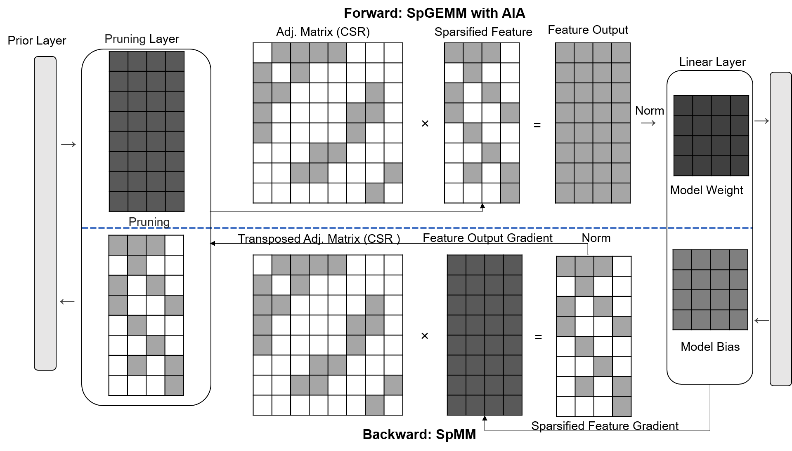
GNN Workload: AIA+Pruning
0
1
4
3
2
5
6
7
Graph structure

Slide 13
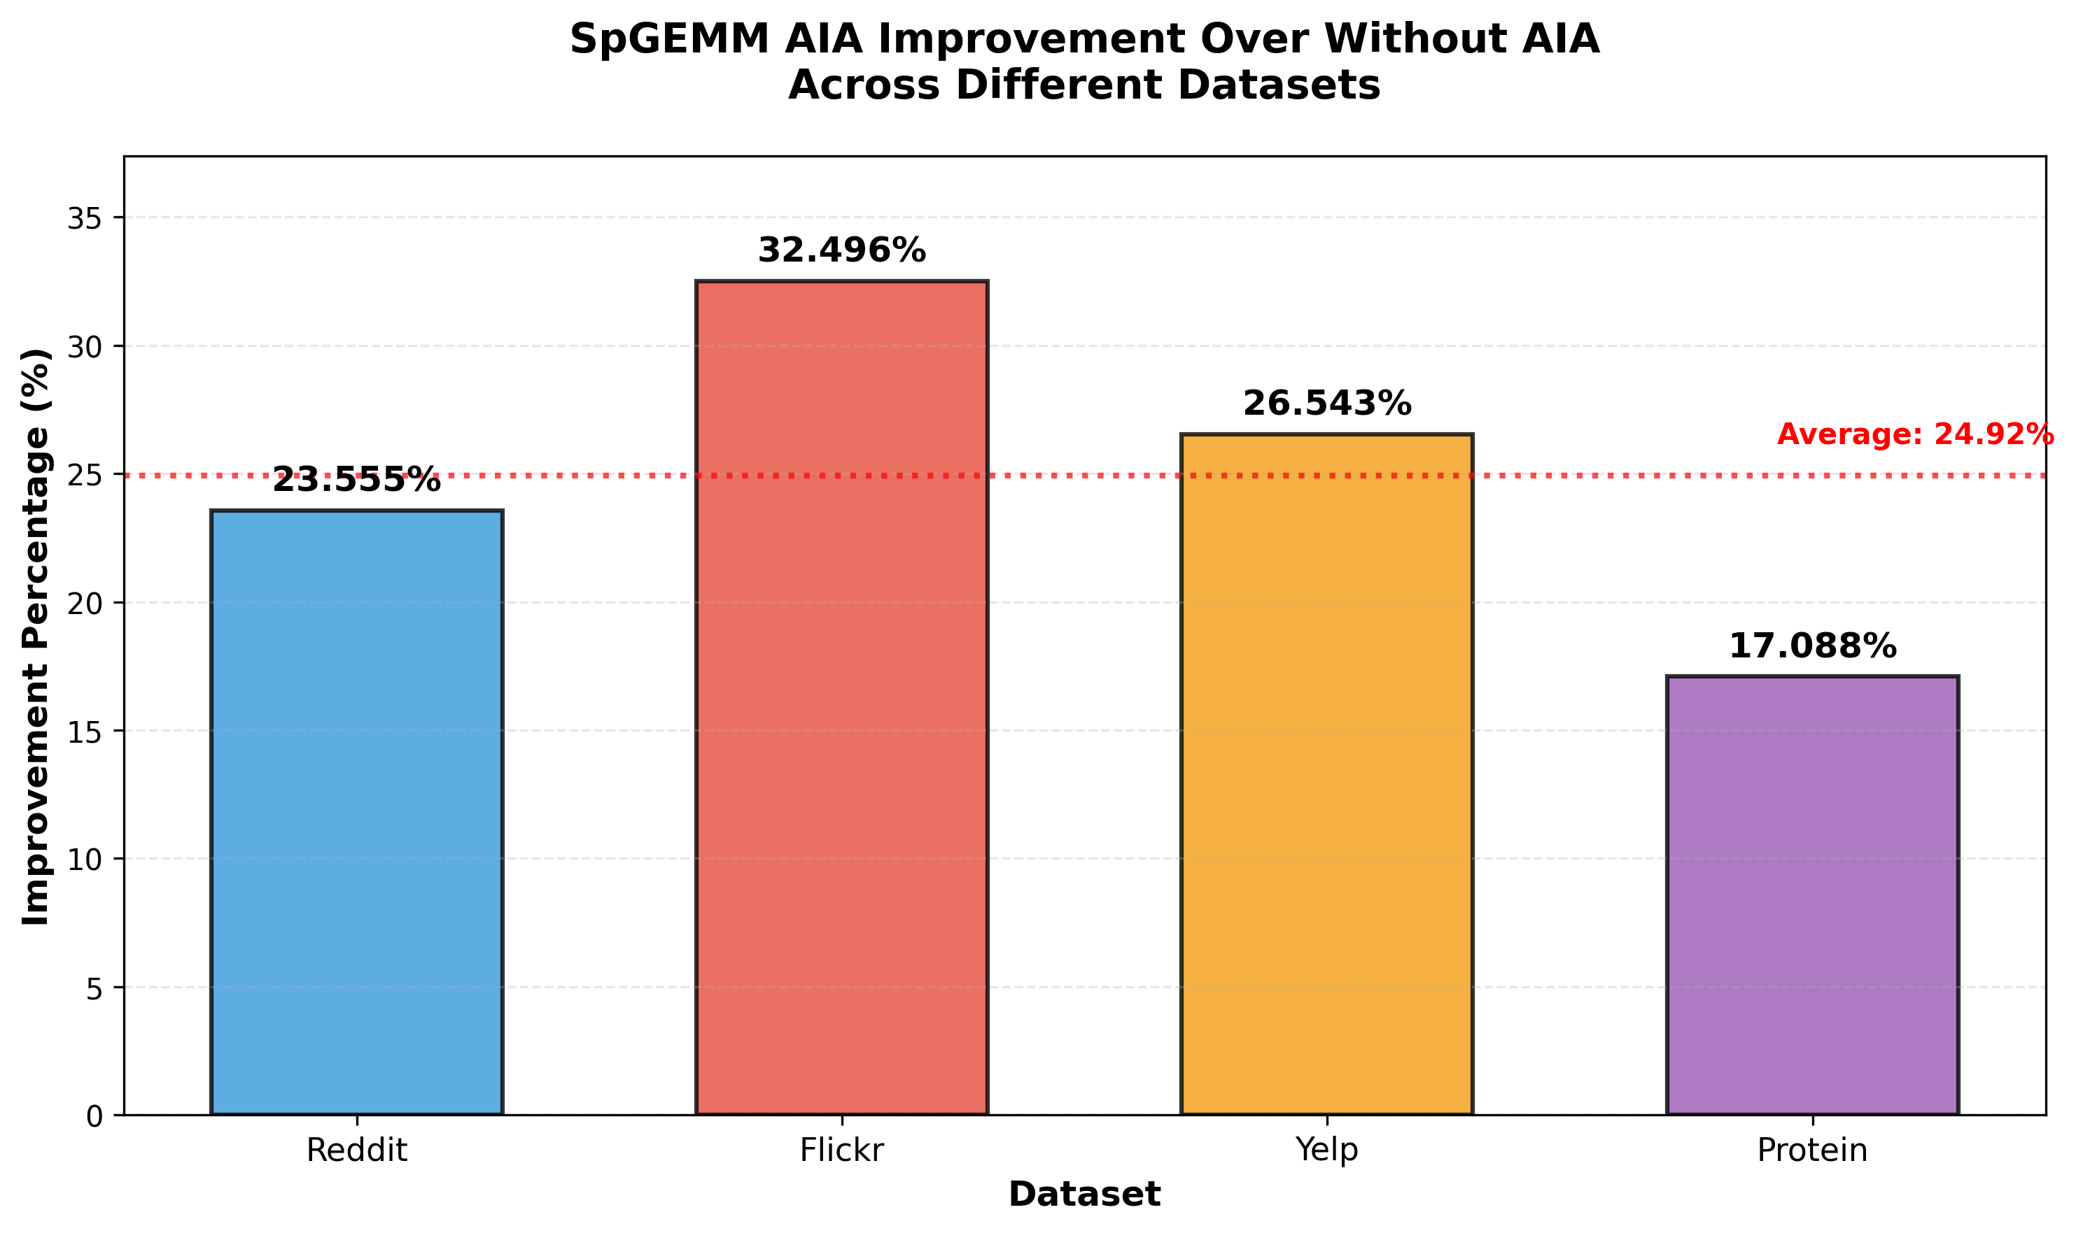
AIA improvement on SPGEMM for GNN Datasets
Notes:
• AIA shows 20-60% improvement over CuSparse
• Without AIA shows 10-50% improvement over CuSparse
• Best AIA improvement: protein sage Consistent benefits across all configurations
• AIA provides additional 5-15% boost over baseline"""

Slide 14
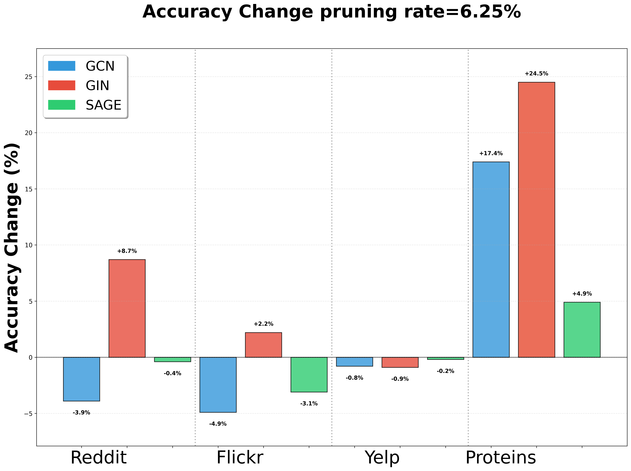
Pruning Impact on Accuracy

Slide 15
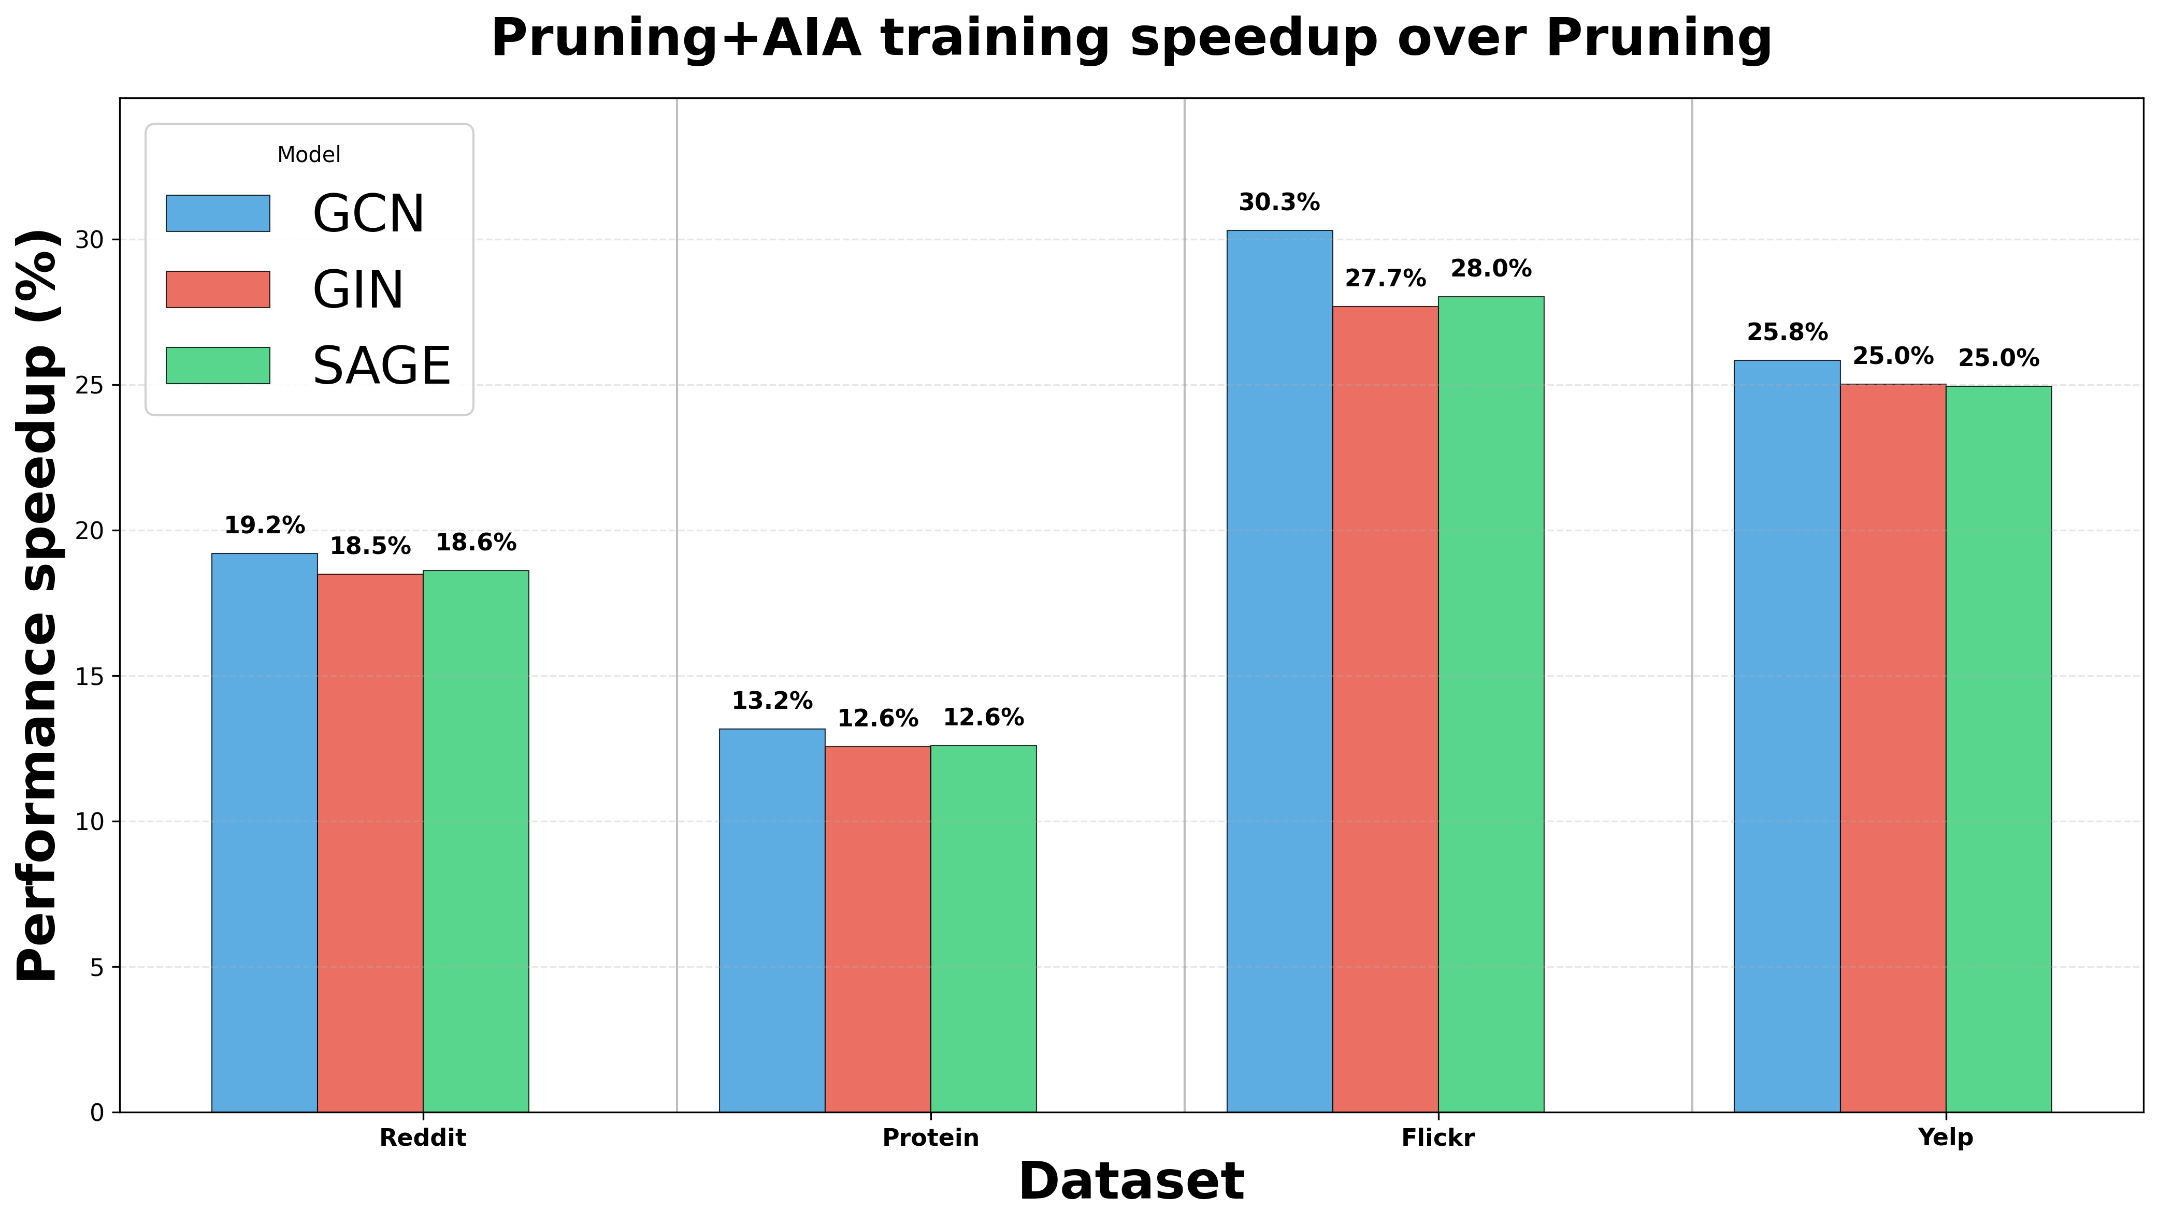
AIA Speedup on GNN Training
Average 21.4%

Slide 16
Summary
AI/HPC requires increasingly higher bandwidth and higher capacity memory
Sparse data increase the complexity of data processing and more memory space
We are researching various technologies to improve memory BW and usage with HBM
AIA, Processing Near Memory for HBM can alleviate memory bottleneck issues
AIA with HBM could show the performance improvement for AI and HPC
AIA needs to expand its application domain to become a more general technology
We are looking for more AIA functions which are simpler, more general but powerful
We are looking for more examples how AIA improves the performance for HPC and AI training and inferencing

Slide 17
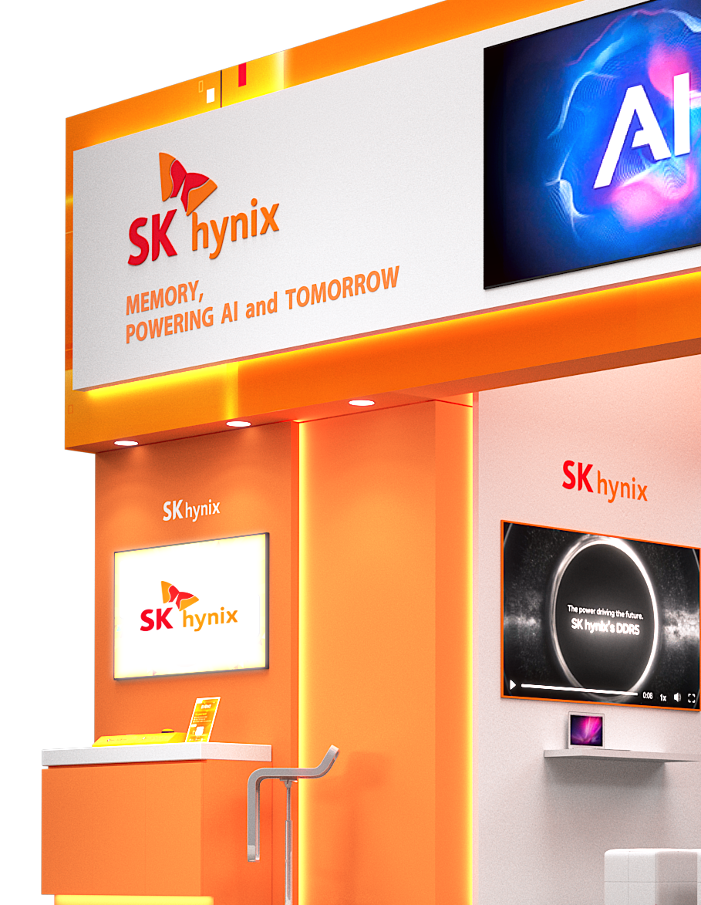



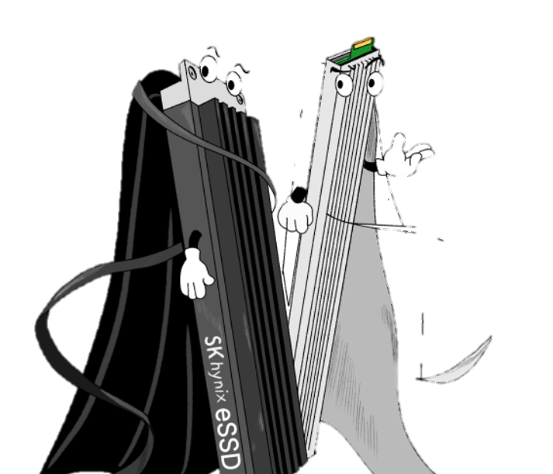
Booth
#207
Meet the future of memory.
Just steps from the entrance.
Innovation starts here,
Literally.

Slide 18
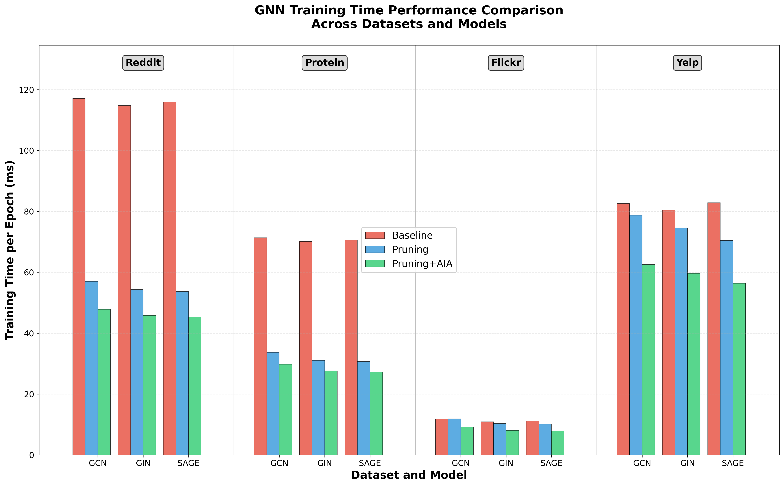
GNN Training Time Comparison

